Slide 1
Quick, Formative, and Valid Reading Assessment: How to Identify Strengths and Concerns in Your Students' Reading
Timothy Rasinski, Ph.D.
Reading and Writing Center
Kent State University
Kent, Ohio
trasinsk@kent.edu

Slide 2
Just for Fun October Word Ladder
Kin

Slide 3
Just for Fun October Word Ladder
Kin
King

Slide 4
Just for Fun October Word Ladder
Kin
King
Wing

Slide 5
Just for Fun October Word Ladder
Kin
King
Wing
Wink

Slide 6
Just for Fun October Word Ladder
Kin
King
Wing
Wink
Pink

Slide 7
Just for Fun October Word Ladder
Kin
King
Wing
Wink
Pink
Pin

Slide 8
Just for Fun October Word Ladder
Kin
King
Wing
Wink
Pink
Pin
Pun

Slide 9
Just for Fun October Word Ladder
Kin
King
Wing
Wink
Pink
Pin
Pun
Pup

Slide 10
Just for Fun October Word Ladder
Kin
King
Wing
Wink
Pink
Pin
Pun
Pup
Pump

Slide 11
Just for Fun October Word Ladder
Kin
King
Wing
Wink
Pink
Pin
Pun
Pup PUMPKIN
Pump

Slide 12
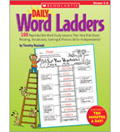
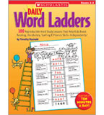
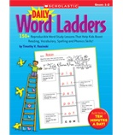

Slide 13
Why Assessment?

Slide 14
Why Assessment?
Identify students who are doing well and not so well in reading.

Slide 15
Why Assessment?
Identify students who are doing well and not so well in reading.
Identify strengths and concerns in students’ reading (diagnosis).

Slide 16
Why Assessment?
Identify students who are doing well and not so well in reading.
Identify strengths and concerns in students’ reading (diagnosis).
Monitor progress / monitor effectiveness of intervention.

Slide 17
Principles of Assessment
Valid and Reliable

Slide 18
Principles of Assessment
Valid and Reliable
Involve Authentic Reading

Slide 19
Principles of Assessment
Valid and Reliable
Involve Authentic Reading
Focus on Recognized Components of Reading - Comprehensive

Slide 20
Principles of Assessment
Valid and Reliable
Involve Authentic Reading
Focus on Recognized Components of Reading- Comprehensive
Must be Sensitive to Changes in Students’ Reading Proficiency

Slide 21
Principles of Assessment
Valid and Reliable
Involve Authentic Reading
Focus on Recognized Components of Reading - Comprehensive
Must be Sensitive to Changes in Students’ Reading Proficiency
Must Allow for Teacher Observation and Analyses

Slide 22
Principles of Assessment
Valid and Reliable
Involve Authentic Reading
Focus on Recognized Components of Reading-
Comprehensive
Must be Sensitive to Changes in Students’ Reading Proficiency
Must Allow for Teacher Observation and Analyses
Must be Time Efficient

Slide 23
Components of Proficient Reading
Word Recognition/Decoding Accuracy
Fluency -- Word Recognition Automaticity
Fluency – Prosody /Expression
Vocabulary – Word Meaning
Comprehension – Text Understanding

Slide 24
Word Recognition Accuracy
Have student read grade level passage aloud in normal voice.
Mark any uncorrected errors made or words pronounced by the examiner.
Determine percentage of word reads accurately. (Total words minus marked errors, divided by total words)
92-98% words read accurately = adequate word recognition accuracy.

Slide 25
Word Recognition Accuracy
Have student read grade level passage aloud in normal voice.
Mark any uncorrected errors made or words pronounced by the examiner.
Determine percentage of word reads accurately. (Total words minus marked errors, divided by total words).
92-98% words read accurately = adequate word recognition accuracy.

Slide 26
Word Recognition Accuracy
Have student read grade level passage aloud in normal voice.
Mark any uncorrected errors made or words pronounced by the examiner.
Determine percentage of word reads accurately. (Total words minus marked errors, divided by total words).
92-98% words read accurately = adequate word recognition accuracy.

Slide 27
Word Recognition Accuracy
Have student read grade level passage aloud in normal voice.
Mark any uncorrected errors made or words pronounced by the examiner.
Determine percentage of word reads accurately. (Total words minus marked errors, divided by total words).
92-98% words read accurately = adequate word recognition accuracy.

Slide 28
Fluency – Word Recognition Automaticity
Word Recognition Automaticity is measured by reading rate or reading speed.
BIG CAVEAT: Reading rate or speed, however, does not cause Word Recognition Automaticity. We don’t teach fluency-automaticity by making students read fast.

Slide 29
Fluency – Word Recognition Automaticity
Use the same reading that was done for Word Recognition Accuracy.
Using a stop watch or other timing device to mark where the student is in one minute (60 seconds) of reading.
Calculate the number of words read correctly in one minute (WCPM).
Compare WCPM score against established norms for grade level and time of year.

Slide 31
Fluency – Prosody/Expression
Use the same reading that was done for Word Recognition Accuracy.
Rate the student’s oral reading prosody against a multi-dimensional scale
Compare Prosody score against recommended norms.

Slide 33
Comprehension
Use the same reading that was done for Word Recognition Accuracy.
After student has read passage, remove the passage from view and ask the student to retell what he or she recalls from the reading.
Rate the retelling against a descriptive rubric or scale.
Interpret the Retelling score.

Slide 35
Vocabulary – Word Meaning
Provide and pronounce 10 grade level words for the student.
Ask student to provide a definition or other evidence of the meaning of the each word (e.g use the word in context).
Score each word as follows: 10 = student has good understanding of the word; 5 = student has partial understanding of the word; 0 = student has no or minimal understanding of the word.
Interpret total score as follows:
80-100 = independent level vocab for grade level
60-75 = instructional level vocab for grade level
< 60 = frustration level vocab for grade level

Slide 36
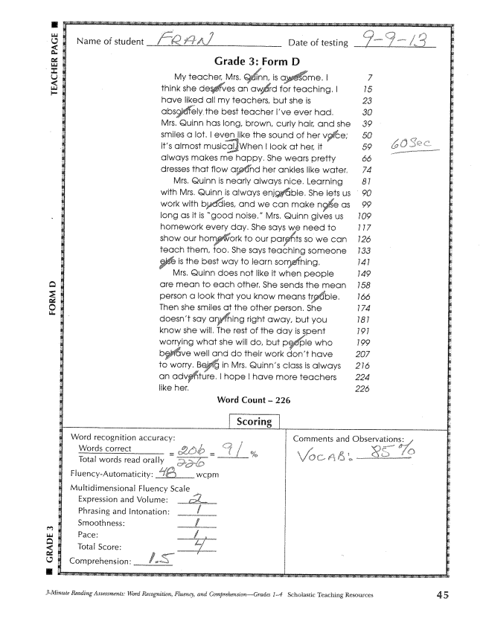

Slide 39
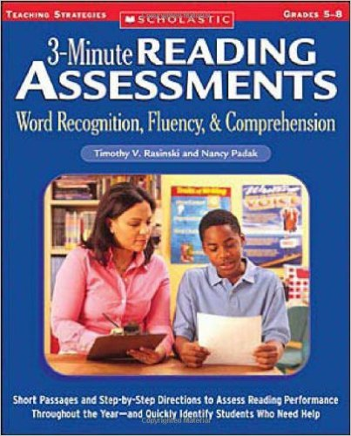

Slide 40
Questions?
Further Information: psi-solutions.org
Contact Dr. Rasinski: trasinsk@kent.edu
THANK YOU FOR ATTENDING

