Slide 1

Managing Concussions in Schools:
Return to Learn!
Presented by Dr. Susan Davies
Associate Professor University of Dayton
This content was developed with support from the Ohio Department of Health

Slide 2



Introduction
Many students who have sustained concussions return to school requiring academic and environmental adjustments while the brain heals.
School personnel are often not trained on
the effects of concussions or ways to help
these students transition back into learning.

Slide 3
Objectives of the Training
⌃
⌃
⌃
TO PROVIDE…
⌃
⌃
⌃
Part 1
Information on how concussions can affect students’ learning, health, and social–emotional functioning
  Part 2
  A suggested concussion team model that involves a designated leader, as well as collaboration among the family, medical personnel, and school team
Part 3
Strategies for “return to learn,” including tools for assessment, symptom-based adjustments to the learning environment, and progress-monitoring

Slide 4
Concussion Effects

Slide 5
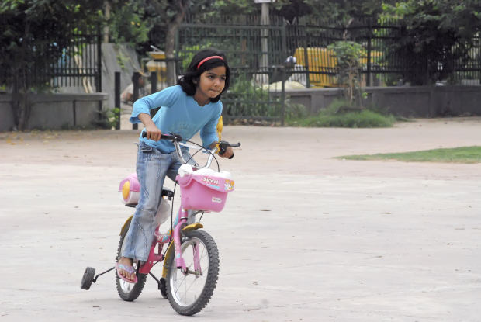
CONCUSSION=MTBI
MILD TRAUMATIC BRAIN INJURY
A concussion is caused by a direct blow or jolt to the head, face, or neck, or a blow to the body that causes the head and brain to shift rapidly back and forth.
  Centers for Disease Control and Prevention. What is a concussion?
  Retrieved from http://www.cdc.gov/headsup/basics/concussion_whatis.html
⌃
⌃
it results in a short-term impairment of neurological function and a constellation of symptoms.
⌃
⌃
⌃

Slide 6
Concussion Facts
  Accurate prevalence estimates are difficult because many do not seek medical attention
Concussions are not visible on standard CT scans or MRIs
Nearly 33% of concussions in athletes still go unreported
(Meehan, Mannix, O’Brien, & Collins, 2013)
Concussions are not only experienced by athletes. Youth ages 5-18 are at increased risk of experiencing a TBI and prolonged recovery
(Gilchrist, Thomas, Xu, McGuire, & Corondo)

Slide 7
Neurometabolic Changes
When one sustains a concussion, neurochemical changes take place in the brain
  Potassium flows out of the brain cells
  Calcium flows into the brain cells
This results in inefficiency of brain cells to properly deliver much-needed nutrients (especially glucose) to the brain.
These molecular changes hinder a person’s ability to engage in many physical or mental activities.
(Giza & Hovda, 2001)

Slide 8
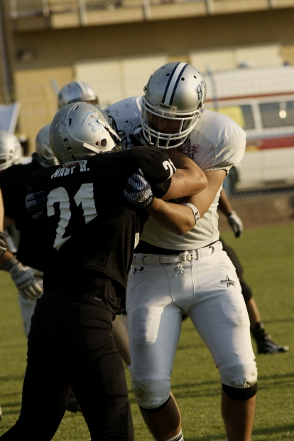
Effects of a Concussion: Signs
Appears dazed or stunned
Is confused about events
Answers questions slowly
Repeats questions
Can’t recall events prior to and/or after the
hit, bump, or fall
May or may not lose consciousness (briefly)
Shows behavior or personality changes
Forgets class schedule or assignments
  Centers for Disease Control and Prevention. “Concussion”. http://www.cdc.gov/concussion/signs_symptoms.html

Slide 9
Danger Signs
⌃
  One pupil larger than the other
  Drowsiness and cannot be awakened
  A headache that gets rapidly worse
  Weakness, numbness, or decreased coordination
  Repeated vomiting or nausea
  Slurred speech
  Convulsions or seizures
  Difficulty recognizing people or places
  Increasing confusion, restlessness, or agitation
  Unusual behavior
  Loss of consciousness (even briefly)
⌃
The student should be seen in an emergency department right away
if s/he has:
⌃
⌃
⌃
⌃
⌃
⌃
⌃
⌃
⌃
Centers for Disease Control and Prevention. Heads Up to Schools:
Know Your Concussion ABCs. Retrieved from http://www.cdc.gov/headsup/schools/index.html

Slide 10
Effects of a Concussion: Symptoms
Cognitive
(thinking)
Physical
Emotional/Mood
Sleep
Feeling slowed down
Difficulty concentrating
Difficulty remembering new information
Headache
Fuzzy or blurry vision
Nausea or vomiting (early on)
Sensitivity to noise or light
Balance problems
Feeling tired/having no energy
Irritability
Sadness
More emotional
Nervousness or anxiety
Sleeping more than usual
Sleeping less than usual
Trouble falling asleep
  Centers for Disease Control and Prevention. “Concussion.” http://www.cdc.gov/concussion/signs_symptoms.html

Slide 11
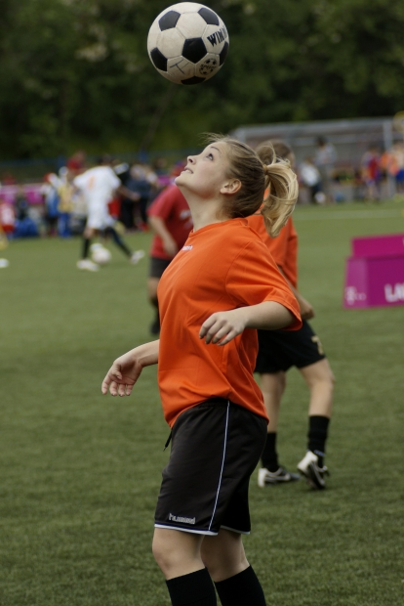
Effects of a Concussion: In School
Symptoms flare when the brain is asked to do more than it can tolerate
(trying to “tough it out” can make symptoms worse)
“Treatment” is physical and
cognitive rest
More on how to achieve this after we discuss how to structure your School-Based Concussion Management Team…

Slide 12
Recovery from Concussion:
How Long Does it Take?
Most recover in 3-4 weeks
Student should receive adjustments until symptoms have resolved
There is a need for balance between the need for physical and cognitive rest and keeping up with schoolwork
Adapted from: Collins et al., 2006, Neurosurgery

Slide 13
Risk Factors for Prolonged Recovery
Constellations of symptoms and recovery speeds are unique.
Some factors affecting recovery include:
Developmental history
Learning disabilities, ADHD, developmental disorders…
  Concussion history
  Once a student sustains a concussion, s/he may be
  at 3-6x higher risk for sustaining another concussion,
  sometimes with less force and often with more
  difficult recovery
  (Guskiewicz, Weaver, Padua, & Garrett, 2000)
History of
migraines/headaches
Psychiatric history
Anxiety, depression, sleep disorders,
other psychological disorders..

Slide 14
Return to Activity Plan
Because every concussion and every student is different, symptom clusters and recovery rates will vary.
  Return to Learn
Return to Play
Students receiving academic adjustments do so because symptoms are present. Students who are symptomatic should not be resuming physical activity.

Slide 15
Concussion Team Model

Slide 16
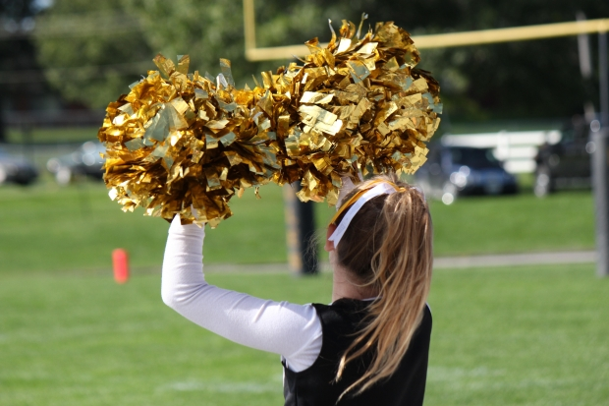
School-based Concussion Team
A concussion team ensures every student who sustains a concussion is monitored for return to activity
When a health issue affects a student’s learning, school teams must communicate effectively with one another, with medical personnel, and with the family.
Listen, validate parents’ feelings, avoid defensiveness, recognize fear and frustration, focus on solutions, work together toward common goals
Notes:
Parents may become overprotective and restrict previously enjoyed freedom (e.g., driving to school, bike riding, climbing on equipment).

Slide 17

School-based Concussion Team
Adapted from Nationwide Children’s Hospital. A School Administrator’s Guide to Academic Concussion Management. Retrieved August 25, 2015
Academic Team Members
Teacher
School Psychologist
School Counselor
Administrator
Speech Language Pathologist
Student & Family
Athletic Team Members
Coach
Athletic Director
Physical Education Teacher
Medical Team Members
School Nurse
Athletic Trainer
Physician

Slide 18

Roles and Responsibilities: Family
TEAM MEMBER
RESPONSIBILITIES
⌃
To clearly and honestly communicate their symptoms, academic difficulties and feelings
To carry out any assigned duties by other team members to the best of their ability
Student
⌃
⌃
⌃
To submit all physician notes and instructions to the school in a timely manner
To help the student maintain compliance with any medical and/or academic
recommendations given to promote recovery
Parent/
Guardian
⌃
⌃

Slide 19

Roles and Responsibilities: Academic Team Members
TEAM MEMBER
RESPONSIBILITIES
⌃
To help the student get the best education possible given the circumstances and to follow
recommended academic adjustments
Teacher
⌃
⌃
School Counselor
To help create (as needed) and disseminate academic adjustments to the student’s teachers
⌃
To be the consultant for prolonged or complicated cases
where long-term adjustments or more extensive
assessment and educational plans may be necessary
School Psychologist
⌃
⌃
To direct and oversee the concussion team plan and
trouble shoot problems
To help create a change in the culture of the school regarding the implementation of programs and policies
Administrator

Slide 20

Roles and Responsibilities:
Medical Team Members
TEAM MEMBER
RESPONSIBILITIES
⌃
To evaluate possible injuries and make referrals for student-athletes
To monitor symptoms and help coordinate and supervise a student-athlete’s safe return to play
To communicate with the school about the student’s progress
Athletic Trainer
(also athletic team member)
⌃
⌃
Physician
To evaluate, diagnose and manage the student’s injury, and to direct medical and academic recommendations
⌃
⌃
To monitor in-school symptoms and health status changes
To help determine if it is appropriate for the student to be
in school or if the student needs any health-related adjustments
School Nurse
⌃

Slide 21

Roles and Responsibilities:
Athletic Team Members
TEAM MEMBER
RESPONSIBILITIES
⌃
To oversee the athletic department’s concussion team plan, including but not limited to: equipment management, policies, coach/athlete/parent education, etc.
Athletic Director
⌃
⌃
To recognize concussion symptoms and remove a potentially injured player from practice or competition
To receive communication from health care providers, parent/guardian and school about readiness to return to play
To communicate with the school about the student’s progress
Coach/Physical Education Director
⌃
⌃
⌃

Slide 22
Concussion Team Leader
The concussion team leader (CTL) is the “central communicator” for all team members
  Oversees the return-to-learn process
  Get Release of Medical Information (ROI) signed for two-way communication between the school and healthcare provider
Depending on roles and responsibilities, it might be the school psychologist, school counselor, school nurse, administrator, or someone else.
  Must be organized, a good communicator, willing to learn, and in the school building most days
  Suggestion: same person as the 504 or IAT coordinator

Slide 23




Concussion Team Process
CTL should notify all teachers/attendance about classroom adjustments. CTL should distribute staff notification letter, Academic Adjustment Plan, and Daily Symptom Log – Progress Monitoring (PM), to teachers.
□ Symptom Log – PM to be completed at least weekly by teachers and returned to CTL
□ Encourage teachers to report signs and symptoms that may be observed in class to the CTL
□ Plan to re-evaluate plan if student is having daily moderate-severe symptoms at school the first week.
Injury reported to CTL as soon as possible.
CTL should review cumulative file to see if
Concussion folder exists from previous injury
Step 1:
Concussion Reported
Step 2:
Contact student & family
Meet with student upon student’s
return to school. CTL also meet with parents to discuss academic plan
Step 3:
Assess medical needs
Has student seen physician or athletic trainer?
Documentation? CTL get signed medical release form.
Assess symptoms and make
attendance decision. CTL start folder
Step 4:
Assess academic needs
Specify general adjustments supplied by
health care provider (if applicable)
Assess academic needs and
Create adjustments. CTL add student to Case Tracking Form
Step 5:
Distribute adjustments
Contact family with relevant updates
on student’s needs and plan. Notify team about student and distribute Symptom Log PM
Update athletic trainer and coach
(if applicable)
Step 6:
Determine Re-assessment
Gain feedback from each team
Decide when to re-assess medical
and academic needs
Adapted from: Nationwide Children’s Hospital. A School Administrator’s Guide to Academic Concussion Management

Slide 24
Concussion Team Process
STEP 1: Concussion is reported to CTL as soon as possible.
• At the beginning of school year, CTL should be identified to teachers, coaches, parents and administrators so the responsible adults know who to report injuries to.
• Anyone in the school community who suspects a concussion should contact the CTL right away so the student can be referred for proper evaluation.
• CTL should review cumulative student file to see if concussion file exists from previous injury

Slide 25
STEP 2: Contact student and family and meet with the student upon return to school.
• CTL explains his/her role & provides contact information
• CTL explains the steps in the management process
• CTL explains the responsibilities of the student & family
  - Honest communication
  Follow recommendations
  Forward physician notes & other relevant documentation
• Explaining responsibilities helps to ensure good communication with, and compliance from, the student and family

Slide 26
STEP 3: Assess medical needs
• The CTL or another designated concussion team member will determine if the student has been evaluated by an athletic trainer or physician, and if the student has documentation from the provider concerning school/activity restrictions and adjustments.
• If no recommendations are available, the CTL or team member should assess symptoms to determine if the student will benefit from being in school or if attendance is likely to be counterproductive.
See Symptom Log
  i. If symptoms are significant or severe, the student may need to be sent home.
  ii. If symptoms are manageable and not becoming significantly worse by attending school, the student may continue to step 4.
• Document as required. CTL get signed Medical Release form from Parent/Guardian for communication between school and physician, if needed. CTL start folder for student.

Slide 27
STEP 4: Assess academic needs
• If there are academic recommendations from the health care provider, the CTL or designated team member should specify those general recommendations.
• If no recommendations are available, the CTL or designated team member should assess the student’s academic needs.
See form titled Academic Adjustments: Concussion
• Document as required. CTL add student to Case Tracking Form.

Slide 28
STEP 5: Distribute adjustments to teachers in writing. Contact family (and if applicable, coach and athletic trainer) with relevant academic/medical updates and plan, as needed. Document as required.
• Notify team about student and distribute Symptom Log – Progress Monitoring.

Slide 29
STEP 6: Identify appropriate timeframe for re-assessment of needs, and using feedback from teams, re-start process at step 3 or 4.
Re-assess medical and/or academic needs when…
New physician documentation arrives dictating a new course of action
Symptoms have changed (and therefore the prior assessment needs to be altered)
Symptoms have resolved and are no longer a barrier to school participation or attendance
Teachers or parents identify problems in current plan that are not being adequately addressed
• Once the re-assessment is complete, document as required, and return to step 5 (notify relevant parties of any changes to the plan), then continue to step 6
(identify appropriate timeframe for re-assessment).
Adapted from: Nationwide Children’s Hospital. A School Administrator’s Guide to Academic Concussion Management

Slide 30
A Note on Student Privacy
Information on a student’s health is protected by HIPAA
(hhs.gov/ocr/privacy/hipaa/understanding/index.html)
Information on a student’s school records is protected by FERPA (www2.ed.gov/policy/gen/guid/fpco/ferpa/index.html)
Remind staff members to only discuss what is necessary to manage the situation and that they understand how to appropriately communicate what is involved in this plan in a way that maintains student privacy

Slide 31
Gaining support from the school community
Keep it simple, introducing the key concepts first and gaining support from responsive faculty members.
  Create opportunities for meaningful discussion
Promote feedback. How can the initiative be improved?
Provide training and ongoing professional development in a way that is easily accessible.
Be patient: Systems change takes time.

Slide 32
Return to School

Slide 33

Return to School Progression
Initially, it is important to rest the
brain & get good sleep
Limit physical, emotional, or cognitive activities to a level that is tolerable and does not exacerbate or cause re-emergence of symptoms
Exertion (and rest) falls along a continuum
No activity/full rest
Full activity/no rest

Slide 34
Cognitive Rest
If student stays home, s/he must avoid extensive computer/tablet use, texting, video games, television, music, loud music, and music via headphones
These activities make the brain work harder to process information and can exacerbate symptoms, thereby slowing recovery

Slide 35
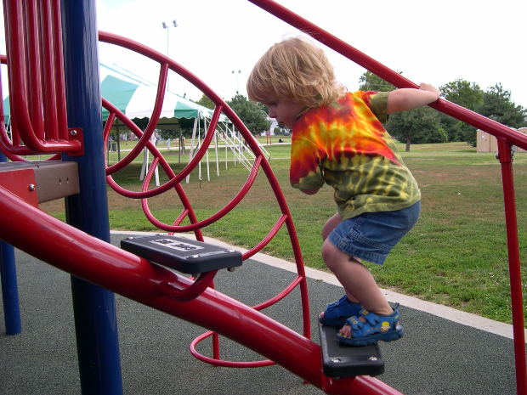
Physical Rest
No participation in any physical activity until cleared by a physician, including physical education and sport activities
  Physical activity after a concussion often magnifies already existing symptoms and puts the child at risk for a second, potentially more serious, concussion.

Slide 36
Return to Academics Progression
(SEE HANDOUT FOR DESCRIPTIONS)
Steps | Progression
1 | No School—Cognitive and Physical Rest Family should receive guidance from health care professional regarding student’s readiness to return to school (based on number, type, and severity of symptoms)
2 | Partial Day Attendance with Adjustments Maximum accommodations Shortened day/schedule; breaks
3 | School—Full day with adjustments
4 | School—Full day without adjustments No physical activity until released by a healthcare professional
5 | School—Full day with extracurricular involvement

Slide 37
Decision-Making Chart
Increase cognitive demand
Allow participation to an
extent that does not
worsen symptoms
Symptoms increase
or worsen
No change in
symptoms
Discontinue activity.
complete cognitive
rest for 20 minutes
Continue gradually
increasing cognitive
demands
Symptoms improve
with 20 minutes
of rest.
Symptoms do not
improve with
20 minutes of rest
Re-start activity at
or below the same
level that produced
symptoms.
Discontinue activity
and resume when
symptoms have
lessened
(such as next day)

Slide 38

Academic Adjustments Following Concussion
Front-load academic adjustments
Note: Students may be reluctant to accept adjustments and instead push through symptoms to complete work because of the anxiety associated with work piling up (Halstead et al., 2013; Sady, Vaughan, & Gioia, 2011)
Map adjustments onto symptoms
see following slides for details…
General
Cognitive/Thinking
Fatigue/Physical
Emotional
Determine how to modify work load
(Heintz, 2012)
Excused assignments
-not to be made up-
Accountable assignments
-responsible for content, not process-
Responsible assignments
-must be completed by student and will be graded-

Slide 39
Academic Adjustments: General
Adjust class schedule (alternate days, shortened day, abbreviated class, late start day).
Avoid noisy and over-stimulating environments (i.e., band) if symptoms increase.
Allow students to drop high level or elective classes without penalty if adjustments go on for a long period of time.
No PE classes until cleared by a healthcare professional. No physical play at recess.
Remove or limit testing and/or high-stakes projects.
Allow students to audit class (i.e., participate without producing or grades).
Alternate periods of mental exertion with periods of mental rest.

Slide 40
Academic Adjustments: Cognitive/Thinking
Reduce class assignments and homework to critical tasks only. Exempt non-essential written class work or homework. Base grades on adjusted homework.
Allow student to demonstrate understanding orally instead of writing.
Provide written instructions for work that is deemed essential.
Provide extended time to complete assignments/tests. Adjust due dates.
Provide class notes by teacher or peer. Allow use of computer, smart phone, tape recorder.
Once key learning objective has been presented, reduce repetition to maximize cognitive stamina (e.g., assign 5 of 30 math problems).
Allow use of notes for test taking..

Slide 41
Academic Adjustments: Fatigue/Physical
Allow time to visit school nurse/counselor for headaches and other symptoms
Allow student to wear sunglasses indoors. Control for light sensitivity (e.g., draw blinds, sit away from window, hat with brim).
Allow student to study or work in a quiet space away from visual and noise stimulation.
Allow strategic rest breaks (e.g., 5-10 minutes every 30-45 minutes) during the day.
Allow student to spend lunch/recess in a quiet space for rest and control for noise sensitivity.
Allow hall passing time before or after crowds have cleared.
Provide a quiet environment to take tests.

Slide 42
Academic Adjustments: Emotional
Develop a plan so student can discreetly leave class as needed for rest.
Encourage student to explore alternative activities of non-physical nature.
Keep student engaged in extra-curricular activities. Allow student to attend but not fully participate in sports practice.
Develop an emotional support plan for the student (e.g., identify adult to talk with if feeling overwhelmed).
Provide quiet place to allow for de-stimulation.

Slide 43
When Symptoms Do Not Resolve
  If managed appropriately, symptoms should resolve in a few weeks.
  If problems persist, academic accommodations and student support may be provided through a health plan, a 504 plan, or –in very rare cases– an IEP.
  A student may exaggerate or feign symptoms in order to escape work, continue receiving academic adjustments, or avoid resuming sports. In such cases, the concussion team should meet to collaboratively determine next steps.

Slide 44
Progress Monitoring
  Concussion Symptom Log
    Daily or weekly tracking on 0-6 scale.
    Track Symptom-Specific Academic Adjustments
    The CTL might also ask open-ended questions (e.g., “How is Spanish class?”) to clarify specific courses or tasks that present difficulty.
  As symptoms improve, gradually increase either the:
    Amount of work
    Length of time spent on work
    Type or difficulty of work

Slide 45
After Return to School,
Follow Return to Play Guidelines
Obtain a health care professional’s clearance for a student to return to play after sustaining a concussion.
  Professional with expertise in concussion evaluation and care
  Failure to do so can increase the risk of subtle neuroinflammation, which may become chronic
Return to play when the student is:
  Symptom-free both at rest and with exertion
  Symptom-free with no medication
  Back to baseline on academics (and neurocognitive tests, if available)

Slide 46
Return to Play
The Third International Conference on Concussion in Sport, held in Zurich in 2008, resulted in a Consensus Statement on Concussion in Sport (McCrory et al., 2008).
Recommended that a student athlete proceed through six steps to return to play (the athlete proceeds to the next level if asymptomatic at the current level for at least 24 hours):
  No activity, complete physical and cognitive rest
  Light aerobic activity
  Sport-specific activities and training
  Noncontact drills
  Full-contact practice training after medical clearance
  Game Play

Slide 47
What Do I Do Now?
Create a culture that encourages reporting of known and suspected concussions
Designate a concussion team leader (CTL)
Provide information to all students, parents, and school staff about:
  how concussions can affect learning
  how effective concussion management can decrease likelihood of student experiencing health or academic problems as a result of the concussion
  http://brain101.orcasinc.com/5000/
  http://www.cdc.gov/headsup/index.html
Ensure school procedures are aligned with concussion plan management
Ensure that all team members have a written guide of responsibilities and expectations

Slide 48
REFERENCES
Centers for Disease Control and Prevention. “Traumatic Brain Injury.” Retrieved from www.cdc.gov/Traumatic Brain Injury/statistics.html
  Centers for Disease Control and Prevention. Heads Up to Schools: Know Your Concussion ABCs. Retrieved from http://www.cdc.gov/headsup/schools/index.html
  Collins, M. W., Lovell, M. R., Iverson, G. L., Ide, T., & Maroon, J. (2006). Examining concussion rates and return to play in high school football players wearing newer helmet technology: A three year prospective cohort study. Neurosurgery, 58(2), 275-286.
  Gilchrist, J., Thomas, K., Xu, L., McGuire, L., & Coronado, V. (2011). Nonfatal traumatic brain injuries related to sports and recreation activities among persons aged <19 years—United States 2001-2009. Centers for Disease Control and Prevention Morbidity and Mortality Weekly, 60(39), 1337-1342.
Giza, C. C., & Hovda, D. A. (2001). The neurometabolic cascade of concussion. Journal of Athletic Training, 36(3), 228–235.
Guskiewicz, K. M., Weaver, N. L., Padua, D. A., & Garrett, W. E. (2000). Epidemiology of concussion in collegiate and high school football players. The American Journal of Sports Medicine, 28(5), 643-650.
Halstead, M. E., McAvoy, K., Devore, C. D., Carl, R., Lee, M., & Logan, K. (2013). The council on sports medicine and fitness & the council on school health clinical report: Returning to learning following a concussion. Journal of Pediatrics, 132(5), 948-957.
Heinz, W. (2012). Return to function: Academic accommodations after a sports-related concussion. The OA Update, 4(2), 16-18.
Langlois, J.A., Rutland-Brown, W., & Wald, M.M. (2006). The epidemiology and impact of traumatic brain injury: a brief overview. Journal of Head Trauma and Rehabilitation, 21(5), 375-378
McCrory, P., Meuwisse, W., Johnston, K., Dvorak, J., Aubry, M., Molloy, M., & Cantu, R.(2008). Consensus statement on concussion in sport: The 3rd international conference on concussion in sport held in Zurich, November 2008. Journal of Athletic Training, 4, 434-444.
Meehan WP 3rd, Mannix RC, O'Brien MJ, Collins MW. (2013) The prevalence of undiagnosed concussions in athletes. Clin J Sport Med, 23(5), 339-42.
Nationwide Children’s Hospital. An Educator’s Guide to Concussions in the Classroom. Retrieved from http://www.nationwidechildrens.org/concussions-in-the-classroom
Nationwide Children’s Hospital. A School Administrator’s Guide to Academic Concussion Management. Retrieved from http://www.nationwidechildrens.org/concussions-in-the-classroom
Report to Congress on Mild Traumatic Brain Injury in the United States: Steps to Prevent a Serious Public Health Problem. Atlanta (GA): Centers for Disease Control and Prevention, National Center for Injury Prevention and Control; 2003.

Slide 49

Questions?
Thank you for attending the webinar
For information on PSI services:
  psi-solutions.org
  1-800-841-4774, ext. 229

